Slide 1
DATA DRIVEN ADAPTIVE TRAFFIC SIMULATION OF AN EXPRESSWAY
Abhinav Sunderrajan, Vaisagh Viswanathan, Wentong Cai and Alois Knoll
Presented by: Wentong Cai

Slide 2
Agenda
Background and Motivation.
Symbiotic Traffic Simulation Framework.
Case Study.
Results.
Conclusions and Future Work.

Slide 3
Agenda
Background and Motivation.
Symbiotic Traffic Simulation Framework.
Case Study.
Results.
Conclusions and Future Work.

Slide 4
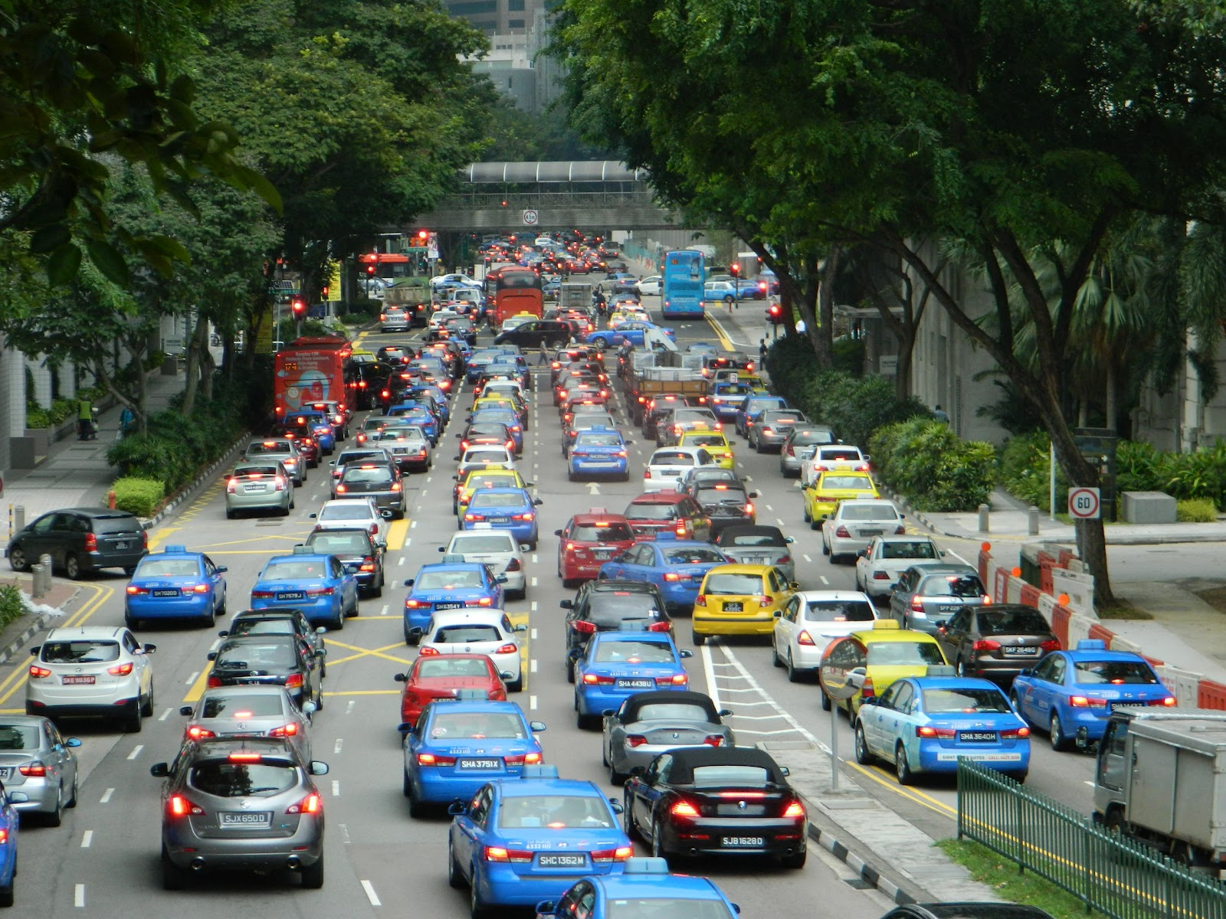
Background and Motivation
Increasing availability of real-time floating car data (FCD)
Taxis and busses equipped with GPS devices.
Anonymized users seeking route guidance from in car navigation systems
GPS accuracy has improved from 15m in the past to about 3m to 5m today.

Slide 5
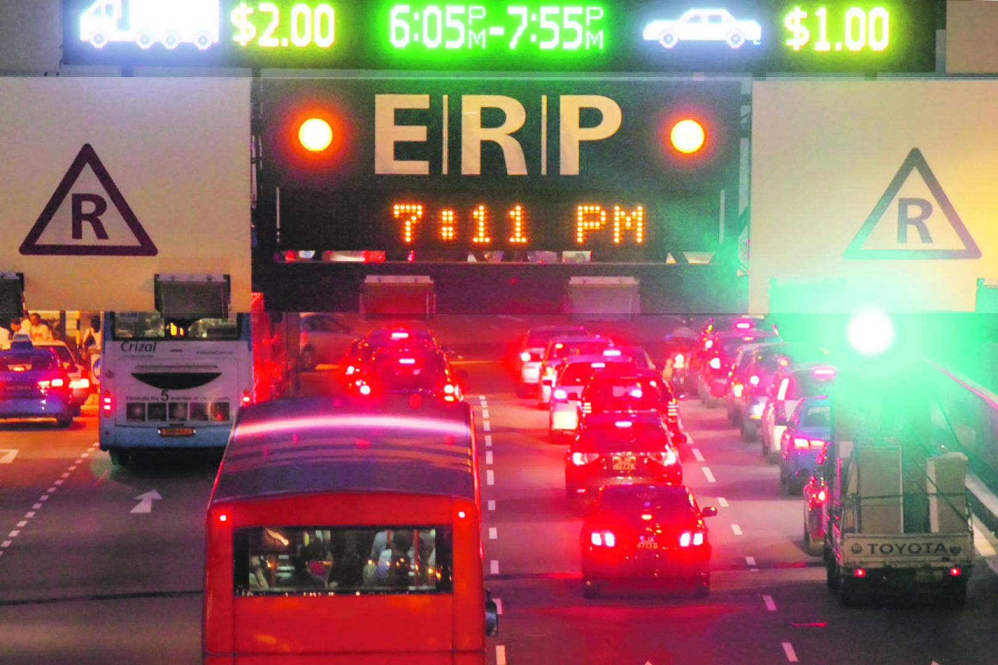
Background and Motivation
Next generation ERP could be Global navigation satellite system based.
Thus most vehicles will have GPS receivers emitting data such as location and speed at fixed time intervals.

Slide 6

Background and Motivation
Can we leverage this real-time data stream for data-driven adaptive traffic flow control and optimization?

Slide 7
Background and Motivation
In this talk, we present a “Symbiotic Traffic Simulation Framework” (STSF).
Symbiotic Simulation is a special class of dynamic data driven adaptive simulation involving a mutually beneficial relationship between the physical system and simulation systems.
The STSF receives continuous inputs from the physical system, i.e., the road network (and the vehicles driving on it) to initialize predictive faster than real time simulations.
Based on the results of the predictive simulations, a recommendation is sent back to control the road network for optimizing traffic flow.

Slide 8
Background and Motivation
The physical system is emulated using a high-fidelity agent based microscopic traffic simulation incorporating acceleration and lane change models.
The prediction & control system receives traffic state inputs from the physical system uses a macroscopic traffic flow model to employ a simulation based optimization strategy.
Finally the recommendations of this predictive & control system are given back to the physical system (microscopic simulation) and evaluated for efficacy.

Slide 9
Agenda
Background and Motivation.
Symbiotic Traffic Simulation Framework.
Overview
Physical System
Prediction system
Optimization Module
Case Study.
Results.
Conclusions and Future Work.

Slide 10
Overview
For a reasonable representation of the physical world, we employ an agent-based microscopic traffic simulation.
The floating car data (FCD) provided by the microscopic simulation was used to initialize the state of the predictive Cell Transmission Model (CTM)* based macroscopic simulation.
The predictive component works hand in hand with the optimization module to give recommendations to the physical system to optimize traffic flow after evaluating several candidate solutions.
In this paper we optimize the traffic flow by simulating a real world expressway employing ramp-metering as the control action.
* The cell transmission model: A dynamic representation of highway traffic consistent
with the hydrodynamic theory”. Transportation Research Part B: Methodological 28 (4): 269–287

Slide 11
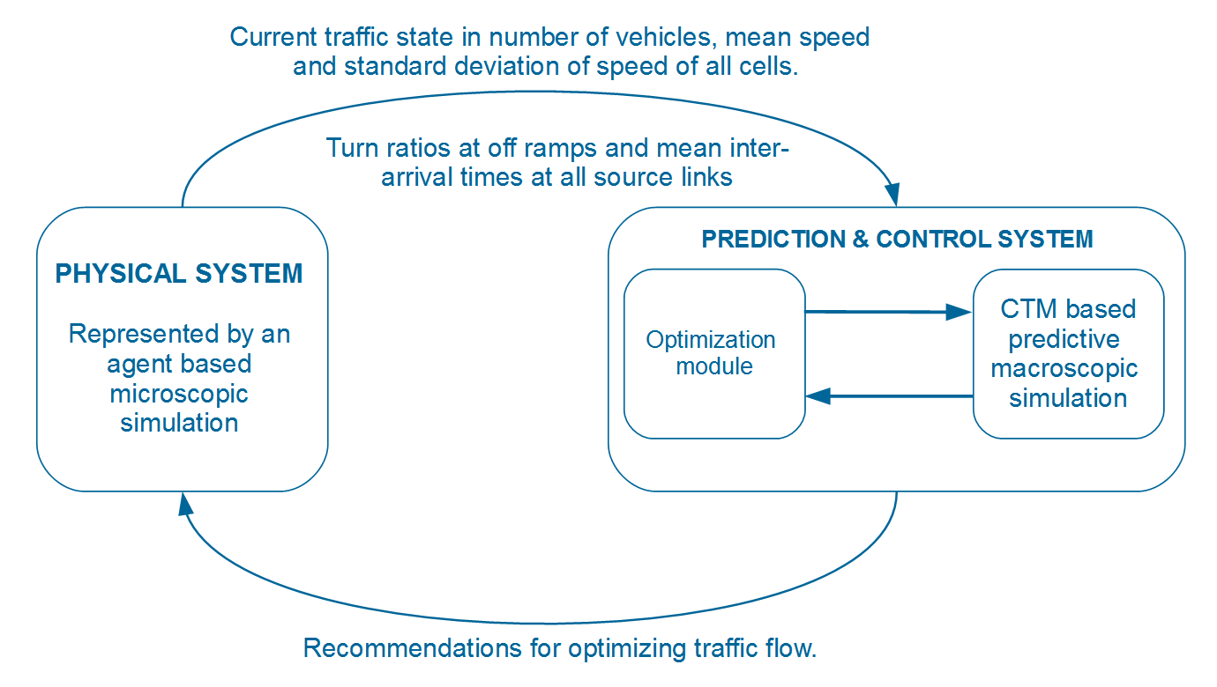
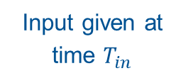

Overview
Input given at time $T_{in}$
Recommendation given at time $T_{in}+∆T$

Slide 12
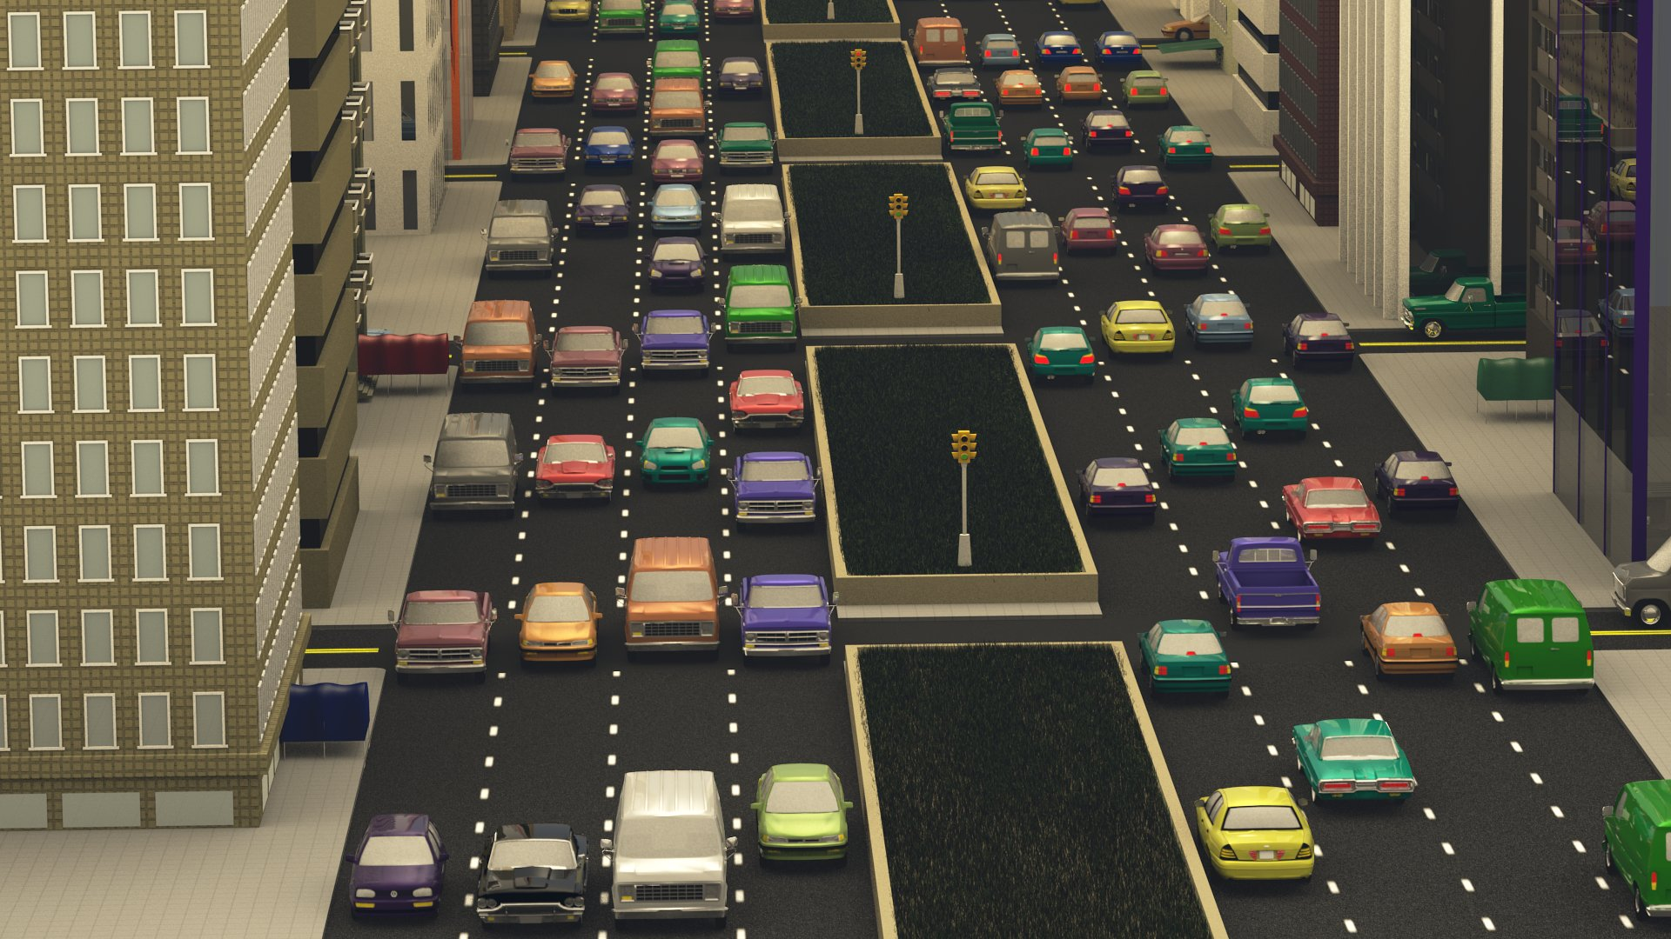
Physical System
We employ agent-based microscopic traffic simulations to model the physical system with high fidelity.
Image courtesy http://gamma.cs.unc.edu/HYBRID_TRAFFIC/

Slide 13
Physical System
The agent-based simulations were employed owing to the enormous amount of resources required to implement the recommendations of the predictive simulation on a real world road network.
Microscopic models describe traffic from the perspective of individual driver-vehicle units (DVUs).
These high fidelity simulations help capture the heterogeneities in traffic in terms of different vehicles classes (e.g. cars, trucks) and driver behaviors (e.g. intelligent, aggressive).
The movement of DVUs are characterized by acceleration models for longitudinal motion and lane change models for lateral movement along the road.

Slide 14
Physical System
The microscopic simulation is based on the SEMSim platform.
SEMSim uses the Intelligent Driver Model (IDM) as the acceleration model for moving the agent/vehicle forward every time-step of the simulation.
The IDM is an accident free model which ensures that a vehicle attains the desired velocity at free flow and maintains the safe bumper to bumper distance to the leading vehicle.
Zehe, D., Knoll, A., Cai, W. and Aydt, H., 2015. SEMSim Cloud Service: Large-scale urban systems simulation in the cloud. Simulation Modelling Practice and Theory, 58, pp.157-171.
Treiber, M. and Kesting, A., 2010. An open-source microscopic traffic simulator. Intelligent Transportation Systems Magazine, IEEE, 2(3), pp.6-13.

Slide 15
Physical System
SEMSim uses MOBIL as the lane change model.
MOBIL ensures that the resultant accelerations and decelerations for a vehicle and its followers in the old and new lanes does not exceed a safe threshold.
A lane change is done only if a vehicle gains speed without violating the safety and inconvenience (to the old and new followers) criteria.
Kesting, Arne, Martin Treiber, and Dirk Helbing. "General lane-changing model MOBIL for car-following models." Transportation Research Record: Journal of the Transportation Research Board (2007).

Slide 16
Physical System
The traffic simulation takes as input a road network consisting of links and the lanes constituting each link.
Road links that do not have a preceding link are considered sources and those without a subsequent link are sinks.
Traffic thus flows from the sources to the sinks.
Vehicles are created at each source as a Poisson process with a constant mean inter-arrival time (IAT).
The route taken by each DVU is determined based on static turn ratios specified at each intersection.

Slide 17
Prediction System
The predictive, faster than real time macroscopic simulation is based on the stochastic variant of the Cell transmission model (Boel and Mihaylova 2006) and METANET (Kotsialos et al. 2002).
The primary reason for employing a macroscopic simulation for the predictive component, is computational efficiency. A gradient-based optimization strategy involves assessing the fitness of several candidate solutions in parallel.
Refer to Sunderrajan et al * for greater details on the algorithm and equations governing the model of the predictive simulation.
*Sunderrajan, A., V. Viswanathan, W. Cai, and A. Knoll. 2016a. “SYMBIOTIC TRAFFIC SIMULATIONFRAMEWORK”. Technical report, TUM CREATE. doi:http://dx.doi.org/10.13140/RG.2.1.2429.9128

Slide 18
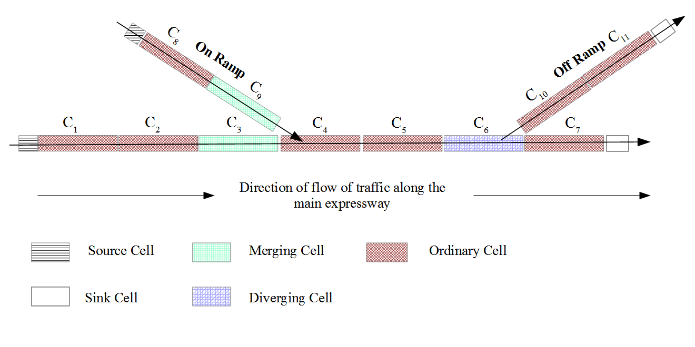
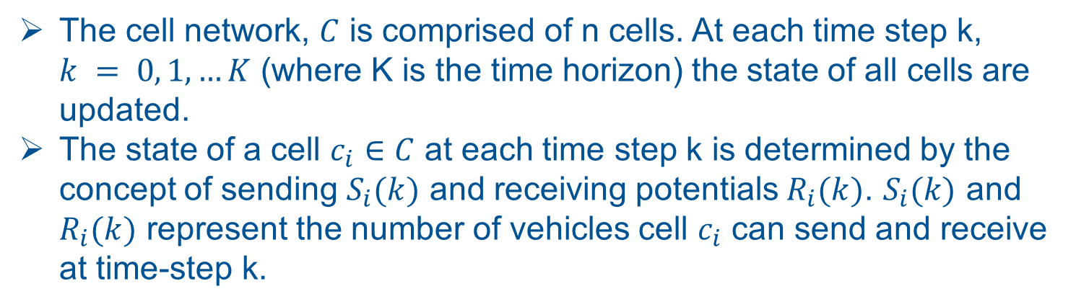
Prediction System
The cell network, $C$ is comprised of n cells. At each time step k, $k = 0, 1, …K$ (where K is the time horizon) the state of all cells are updated.
The state of a cell $c_{i}∈C$ at each time step k is determined by the concept of sending $S_{i}(k)$ and receiving potentials $R_{i}(k)$. $S_{i}(k)$ and $R_{i}(k)$ represent the number of vehicles cell $c_{i}$ can send and receive at time-step k.

Slide 19
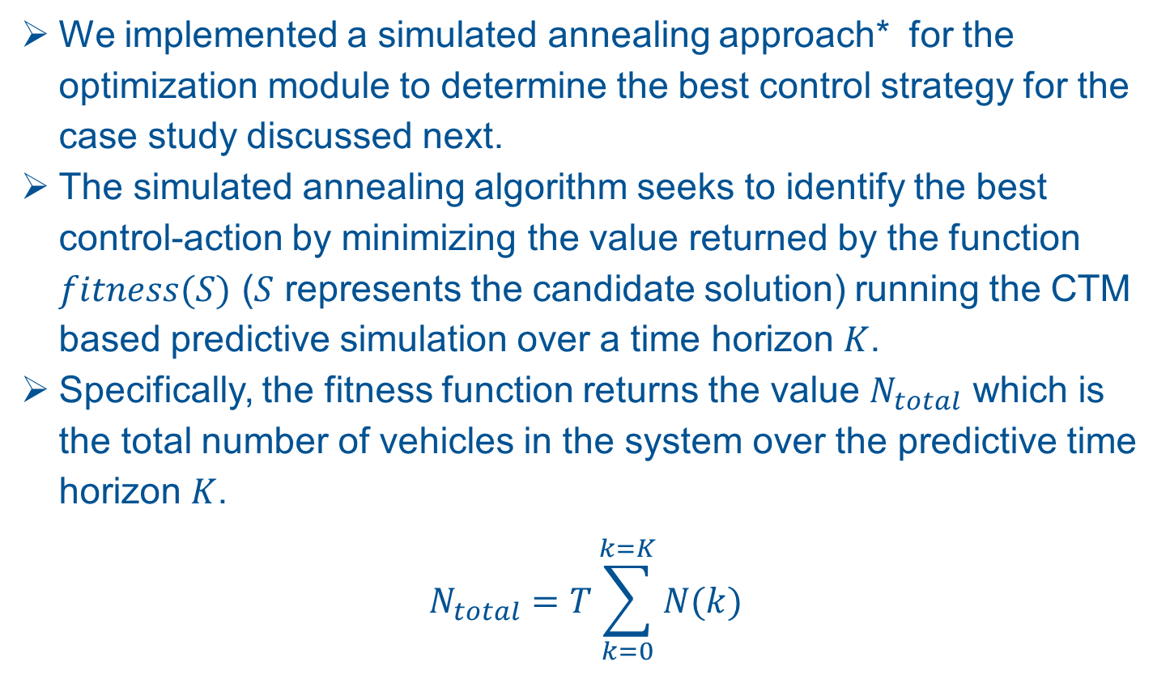
Optimization Module
We implemented a simulated annealing approach* for the optimization module to determine the best control strategy for the case study discussed next.
The simulated annealing algorithm seeks to identify the best control-action by minimizing the value returned by the function $fitness(S)$ ($S$ represents the candidate solution) running the CTM based predictive simulation over a time horizon $K$.
Specifically, the fitness function returns the value $N_{total}$ which is the total number of vehicles in the system over the predictive time horizon $K$.
$$N_{total}=T\sum_{k=0}^{k=K}{N(k)}$$
*Weise, T. 2009. “Global optimization algorithms-theory and application”

Slide 20
Agenda
Background and Motivation.
Symbiotic Traffic Simulation Framework.
Case Study.
Ramp Metering
Simulated Physical Environment
Traffic Scenario
Results.
Conclusions and Future Work.

Slide 21
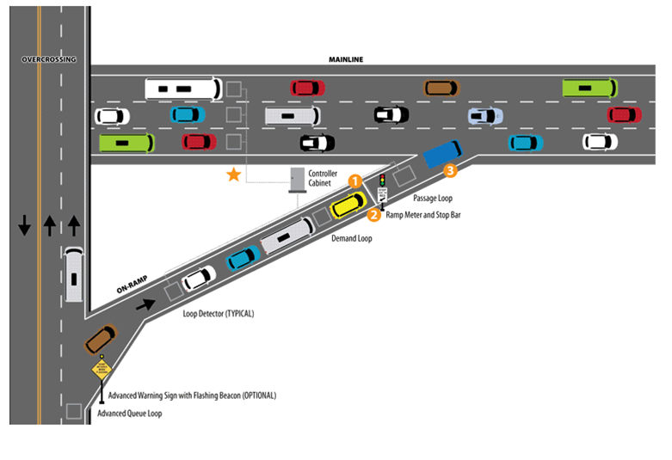
Ramp Metering
Ramp meters are traffic signals placed at the intersection of on-ramps and expressways.
Ramp meters regulate the flow of vehicles along the ramps so as to minimize the turbulence caused due to merging vehicles disrupting the mainline flow.
Care must be taken to ensure that the queue of the vehicles waiting along the on-ramps does not spill into the preceding urban street network.

Slide 22
Ramp Metering
Ramp Metering strategies
Fixed time
Reactive
Local ramp metering
Multivariable regulator strategies
A review on several implemented and proposed ramp-metering strategies can be found in Bogenberger, K., and A. D. May. 1999. “Advanced coordinated traffic responsive ramp metering strategies". California Partners for Advanced Transit and Highways (PATH).
Notes:
1) The fixed time strategy is based on historical data pertaining to flow rates along the on-ramps and
the expressway at different times of the day.
2) Reactive ramp-metering strategies aim to optimize the flow of traffic based on real-time measurements
3) Local ramp metering makes use of measurements in the vicinity of an
on-ramp to regulate the flow on the ramp.
4) Multivariable Regulator strategies makes use of the system wide measurements to simultaneously regulate traffic flow along all on-ramps.

Slide 23
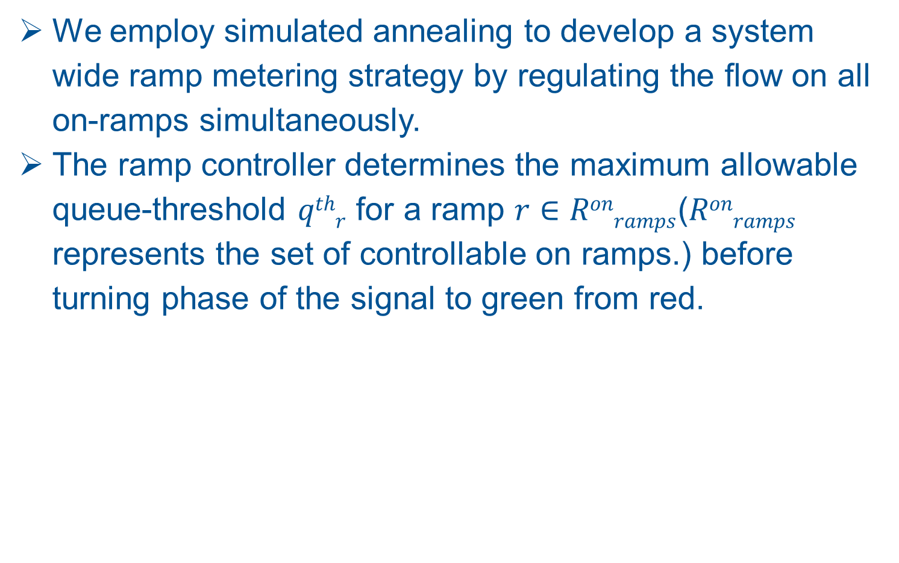
Ramp Metering
We employ simulated annealing to develop a system wide ramp metering strategy by regulating the flow on all on-ramps simultaneously.
The ramp controller determines the maximum allowable queue-threshold $qthr$ for a ramp $r∈Ronramps$($Ronramps$ represents the set of controllable on ramps.) before turning phase of the signal to green from red.

Slide 24
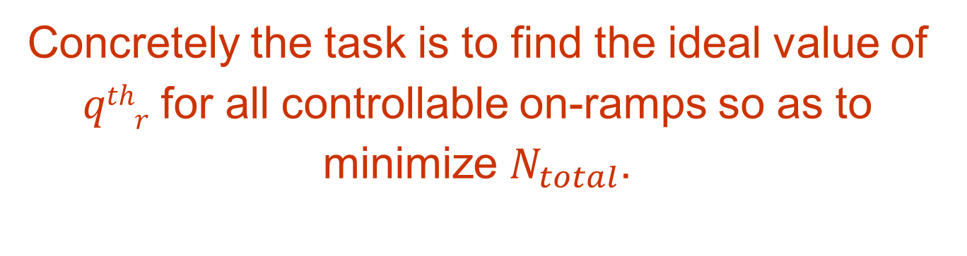
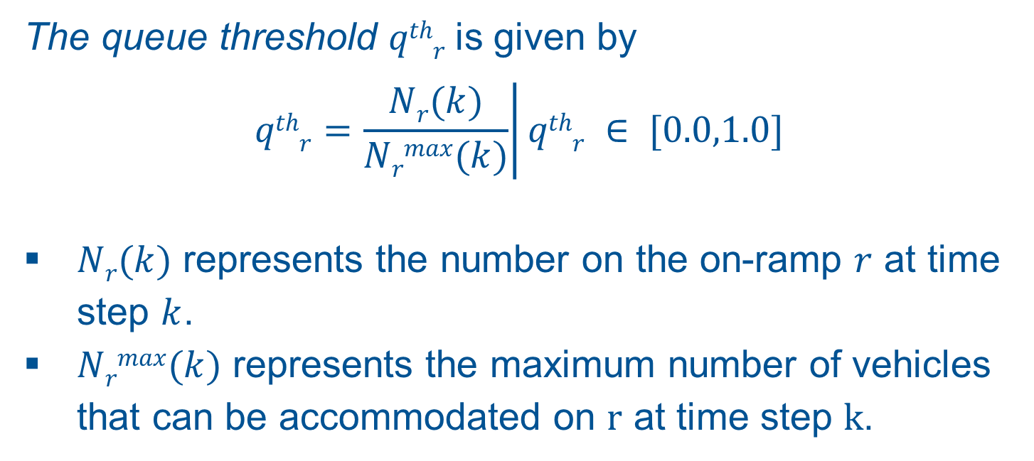
Ramp Metering
The queue threshold $qthr$ is given by
$$\left.qthr=\frac{Nr(k)}{Nrmax(k)}\right|qthr ∈ [0.0,1.0]$$
$Nr(k)$ represents the number on the on-ramp $r$ at time step $k$.
$Nrmax(k)$ represents the maximum number of vehicles that can be accommodated on r at time step k.
Concretely the task is to find the ideal value of $qthr$ for all controllable on-ramps so as to minimize $N_{total}$.

Slide 25
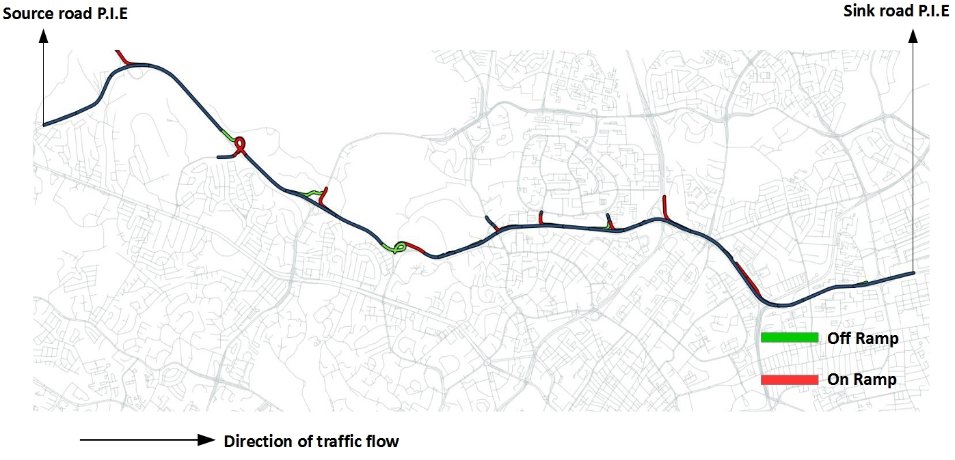
Simulated Environment
13 km stretch of P.I.E (Pan Island Expressway) in central Singapore with all on ramps and off ramps.

Slide 26
Simulated Environment
The on ramps and the first P.I.E link are sources for the vehicles/agents entering the simulation.
The off ramps and the last link on P.I.E are sinks through which the vehicles exit the simulation.
The turn ratios for all off-ramps is kept constant at 0.25. This implies that 25% of all vehicles exit at a given o ramp while the remaining 75% of the vehicles continue to travel on the main expressway.
The number of lanes in the simulated stretch of the expressway varies between 3 and 6.

Slide 27
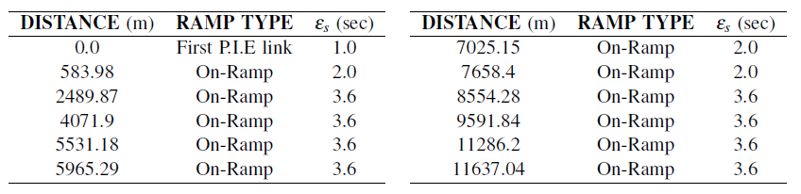
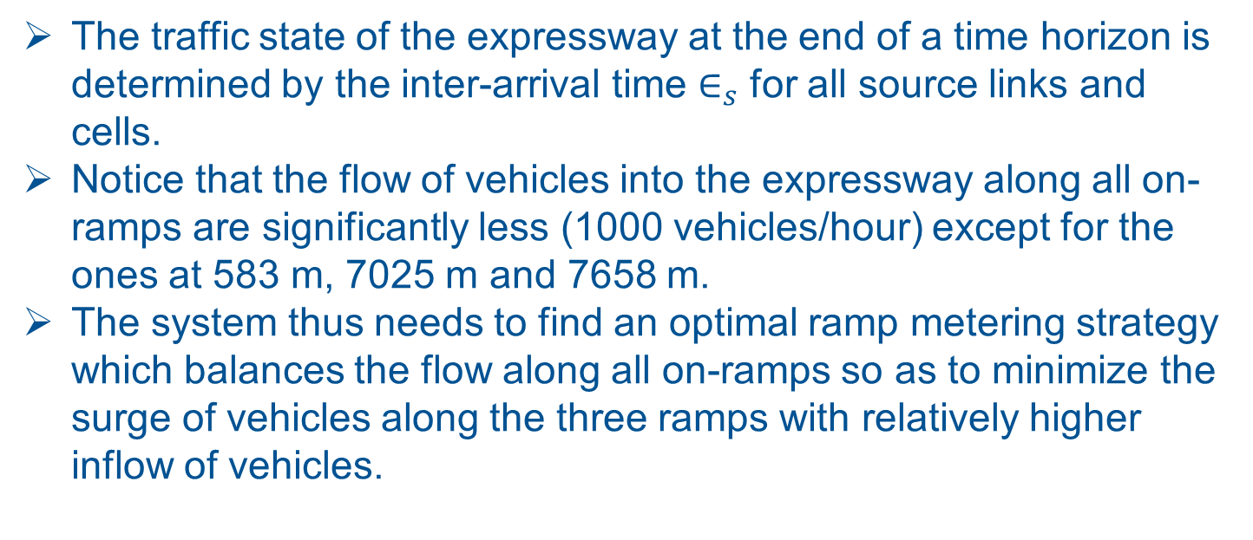
Traffic Scenario
The traffic state of the expressway at the end of a time horizon is determined by the inter-arrival time $∈_{s}$ for all source links and cells.
Notice that the flow of vehicles into the expressway along all on-ramps are significantly less (1000 vehicles/hour) except for the ones at 583 m, 7025 m and 7658 m.
The system thus needs to find an optimal ramp metering strategy which balances the flow along all on-ramps so as to minimize the surge of vehicles along the three ramps with relatively higher inflow of vehicles.

Slide 28
Agenda
Background and Motivation.
Symbiotic Traffic Simulation Framework.
Case Study.
Results.
Calibration of predictive Simulation
Experimental setup
Efficacy of Ramp Metering
Computational efficiency
Conclusions and Future Work.

Slide 29
Calibration of predictive simulation
To ensure that the state predicted by the macroscopic simulation accurately represents the state of the physical system, the model parameters (of the predictive macroscopic simulation) have to be calibrated.
The parameters which will have significant impact in terms of bridging the difference in the state of the physical system and that of the predictive simulation at the end of a given time horizon.
Note that calibration of the predictive simulation with respect to the physical system is an offline one step process.

Slide 30
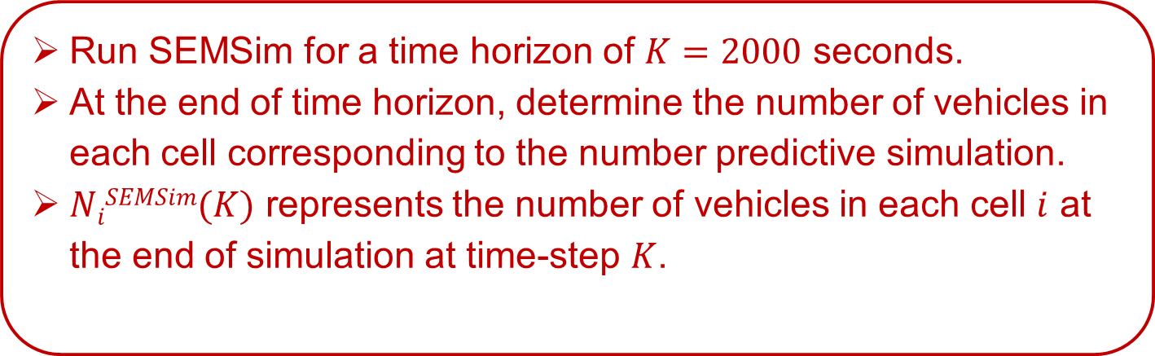
Calibration of predictive Simulation
PHYSICAL SYSTEM (SEMSim, microscopic traffic simulation)
Initialize the turn ratios for all off-ramp expressway intersections.
Initialize the mean inter-arrival rates for all sources.
Run SEMSim for a time horizon of $K=2000$ seconds.
At the end of time horizon, determine the number of vehicles in each cell corresponding to the number predictive simulation.
$NiSEMSim(K)$ represents the number of vehicles in each cell $i$ at the end of simulation at time-step $K$.

Slide 31
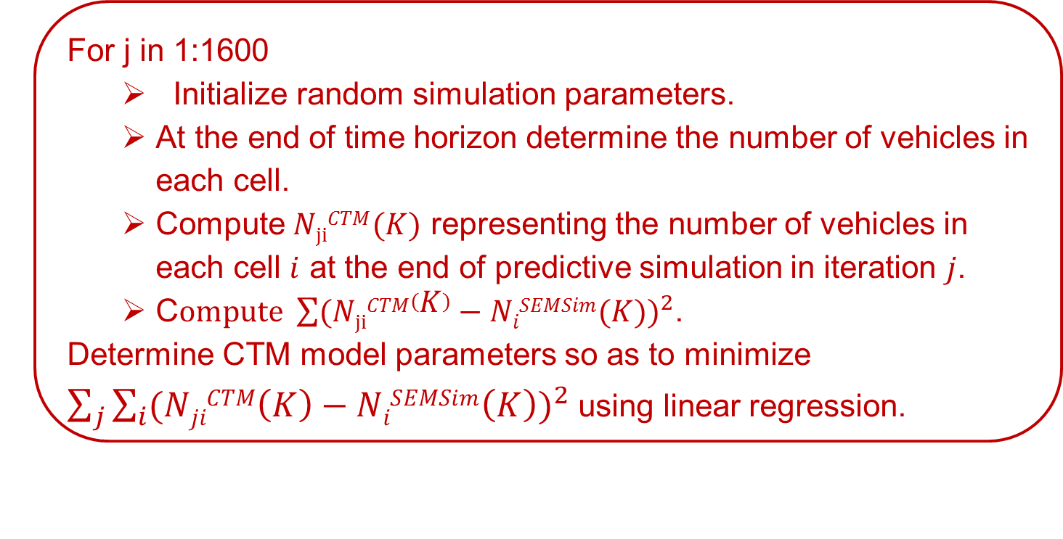
Calibration of predictive Simulation
CTM based predictive simulation
Initialize the turn ratios for all off-ramp expressway intersections.
Initialize the mean inter-arrival rates for all sources.
(same values as the physical system represented by SEMSim)
For j in 1:1600
Initialize random simulation parameters.
At the end of time horizon determine the number of vehicles in each cell.
Compute $NjiCTM(K)$ representing the number of vehicles in each cell $i$ at the end of predictive simulation in iteration $j$.
C$ompute \sum{{(NjiCTM\left(K\right)−NiSEMSim(K))}^{2}}$.
Determine CTM model parameters so as to minimize $\sum_{j}{\sum_{i}{{(NjiCTM\left(K\right)−NiSEMSim\left(K\right))}^{2}}}$ using linear regression.

Slide 32
Experimental Setup
Constraints
The minimum phase time for both the red and green phases are 12 seconds.
The signal at an on-ramp can be continuously red only for a maximum of 120 seconds. After a 120 second red phase, there is a mandatory green phase for 24 seconds.
Notes:
The first of the above constraints ensures the phases of traffic lights do not change rapidly.
The second constraint ensures that none of the vehicles wait at an on-ramp for an inordinately long time.

Slide 33
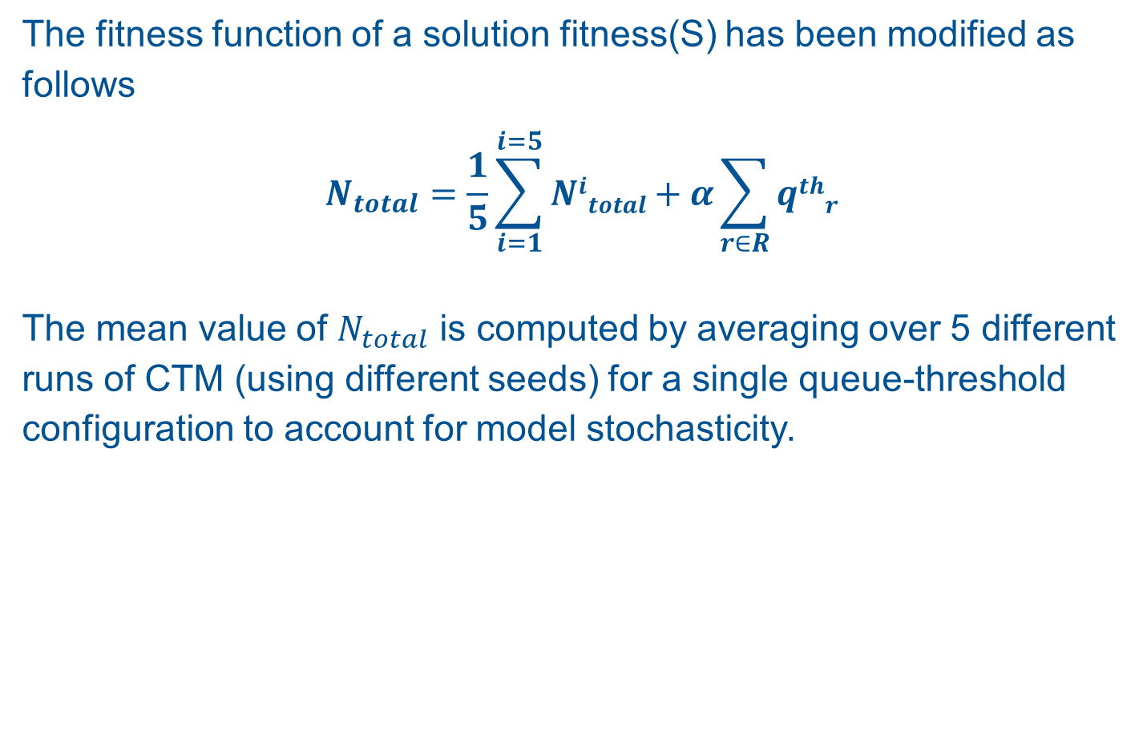
Experimental Setup
The fitness function of a solution fitness(S) has been modified as follows
$$N_{total}=\frac{1}{5}\sum_{i=1}^{i=5}{Nitotal}+α\sum_{r∈R}{qthr}$$
The mean value of $N_{total}$ is computed by averaging over 5 different runs of CTM (using different seeds) for a single queue-threshold configuration to account for model stochasticity.
Notes:
The first of the above constraints ensures the phases of traffic lights do not change rapidly.
The second constraint ensures that none of the vehicles wait at an on-ramp for an inordinately long time.

Slide 34
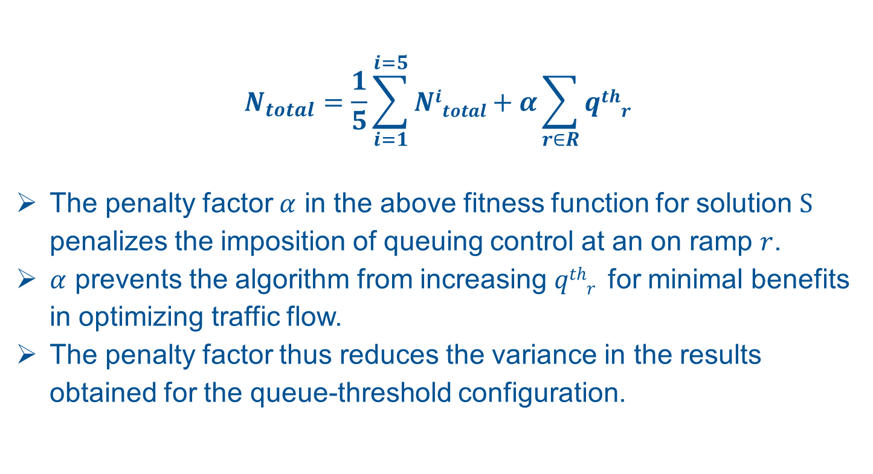
Experimental Setup
$$N_{total}=\frac{1}{5}\sum_{i=1}^{i=5}{Nitotal}+α\sum_{r∈R}{qthr}$$
The penalty factor $α$ in the above fitness function for solution S penalizes the imposition of queuing control at an on ramp $r$.
$α$ prevents the algorithm from increasing $qthr$ for minimal benefits in optimizing traffic flow.
The penalty factor thus reduces the variance in the results obtained for the queue-threshold configuration.
Notes:
The parameter alpha is chosen empirically by observing slowing increasing it from zero. We see that Ntotal also increases. At some point Ntotal drops which is the optimal value of alpha.
This is akin to regularization used in regression, neural networks etc.
The inspiration of this method comes from Lasso Regression for regularization.

Slide 35
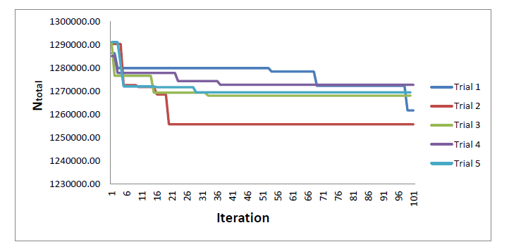

Efficacy of Ramp Metering
Decrease in $N_{total}$ for predictive simulated annealing algorithm.
Each trial represents the average $N_{total}$ of 5 different runs of the prediction model
Notes:
Note that mean inter-arrival rates for each trial is the same as the table in the traffic scenario slide.
The reason I run this experiment several times is to show that simulated annealing is able to find a reasonable solution within 100 iterations or so.

Slide 36
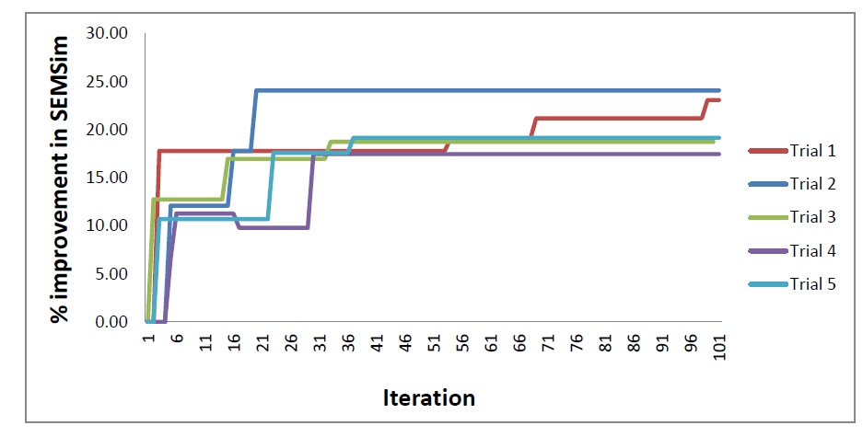

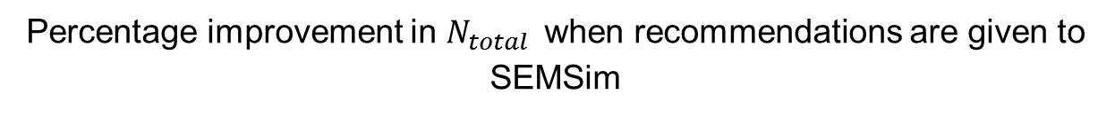
Efficacy of Ramp Metering
Percentage improvement in $N_{total}$when recommendations are given to SEMSim
The percentage improvement in $N_{total}$ for SEMSim when the recommendation of the prediction algorithm is implemented.
Notes:
this slide shows what would be the percentage improvement that we get when the recommendations of the prediction and optimization module is given at each iteration of the simulated annealing algorithm. Note that the recommendation is applied until a time horizon of 1800 seconds to compute N-total.
What I intend to show in this slide is that we can get good improvements even at the end of 30 iteration of simulated annealing and it is not necessary to wait until 100 iterations of the algorithm.

Slide 37
Summary of results
N_{total} as measured in SEMSIM (Physical system) over 5 trials
Iteration Number | Execution time of optimization module (seconds) | Mean with optimization module | Mean without optimization module | SD* with optimization module | SD* without optimization module | Mean Percentage improvement
20 | 10 | 1128254.12 | 1287961.32 | 8993.24 | 4820.26 | 12.4
40 | 19 | 1097403.41 | 1287961.32 | 8170.56 | 4820.26 | 14.6
60 | 29 | 1056970.03 | 1287961.32 | 7757.35 | 4820.26 | 17.6
80 | 35 | 1024460.46 | 1287961.32 | 6405.26 | 4820.26 | 20.1
100 | 47 | 1015430.66 | 1287961.32 | 3028.51 | 4820.26 | 20.52
* SD represents standard deviation.
Notes:
SD is standard deviation

Slide 38
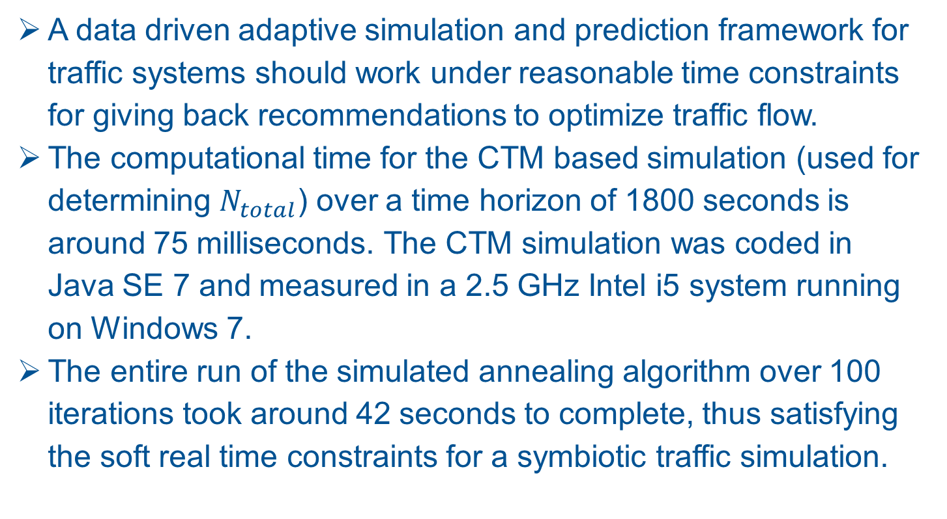
Computational Efficiency of Predictive Simulation
A data driven adaptive simulation and prediction framework for traffic systems should work under reasonable time constraints for giving back recommendations to optimize traffic flow.
The computational time for the CTM based simulation (used for determining $N_{total}$) over a time horizon of 1800 seconds is around 75 milliseconds. The CTM simulation was coded in Java SE 7 and measured in a 2.5 GHz Intel i5 system running on Windows 7.
The entire run of the simulated annealing algorithm over 100 iterations took around 42 seconds to complete, thus satisfying the soft real time constraints for a symbiotic traffic simulation.

Slide 39
Agenda
Background and Motivation.
Symbiotic Traffic Simulation Framework.
Case Study.
Results.
Conclusions and Future Work.

Slide 40
Conclusions
In this work we have shown that data driven predictive simulations can be beneficial towards optimizing traffic flow.
The prediction and optimization system should receive fairly accurate and continuous information on the current traffic state. This information is used for initialization, calibration and steering of the predictive simulations.
The simulation model and optimization strategy used in the prediction & control system can be varied depending upon accuracy, efficacy and computational time constraints.

Slide 41



Overview
Data stream processing
Data from smart phones, GPS receivers and fixed sensors.
Traffic State
Predict and evaluate different control actions
Suggest the best control measure for dynamic traffic flow optimization.
Short term prognosis of traffic flow
Symbiotic Traffic Simulation Platform

Slide 42
Future Work
Symbiotic traffic simulations also offer exciting opportunities to implement and optimize several techniques for traffic flow optimization such as adaptive speed limits and dynamic routing.
Mobile applications and in car navigation systems provide a great means to disperse information to the traffic participants while the control system receives user anonymized data about vehicle speed, location and even origin-destination flows.
This form of a symbiotic simulation based traffic prediction and optimization framework directed towards receiving user anonymized data from individual drivers and providing them personalized updates is an interesting area for future research.

Slide 43
Thanks for you attention!
Any Questions or suggestions?

